Slide 1
Web Development Nanodegree
Session 2
Conducted by: Hamza

Slide 2
Slack & support
https://join.slack.com/t/egypt-fwd-january/shared_invite/zt-kkyuavtt-2g5vb2nBPe26_hbzexPrag
fwd-support@udacity.com
https://forms.udacity.com/forms/fwd-commitment-form-advanced-Jan/
https://github.com/santarabantoosoo/wdnd-presentations

Slide 3
agenda
OOP refreshment
FLASK quick summary
FLASK_SQLALCHEMY quick summary
Breakout rooms

Slide 4
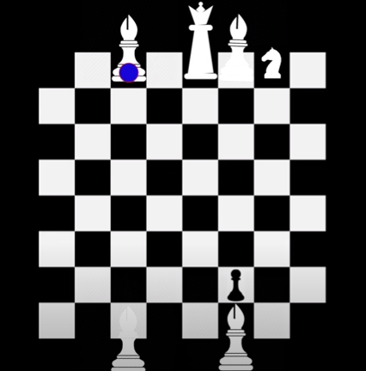
design a game

Slide 5
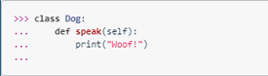
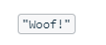
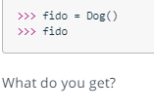

Notes:
object

Slide 6
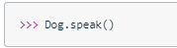
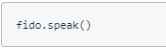

Slide 7
Notes:
How to solve this error ?

Slide 8
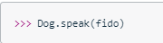
Solution
Notes:
Python doesn't know which object we want to use the method with. Do we mean fido? Or spot? Or some other object?
it is actually possible to call the speak method with a line like Dog.speak()—but we have to put the name of a Dog object inside the parentheses, as in Dog.speak(fido).
When we do this, it assigns the fido object to the self parameter, and this tells Python which object we want to use with the method.
So that is the purpose of the self parameter: It tells Python which particular Dog object we're wanting to use when we call the method.

Slide 9
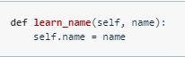
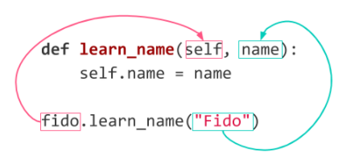
Know urself

Slide 10
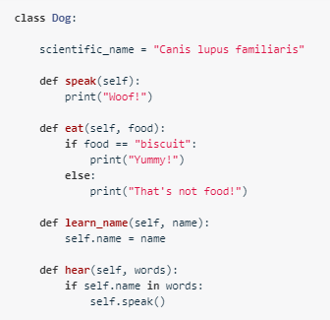
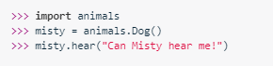
Instance level variables
What’s the expected output?
Notes:
Where are class variables and where are instance level variables ?
The attribute name is created once we call learn_name, which is not called yet.

Slide 11
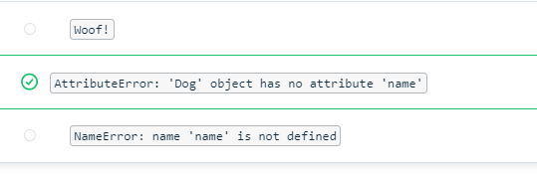
SOLUTION

Slide 12
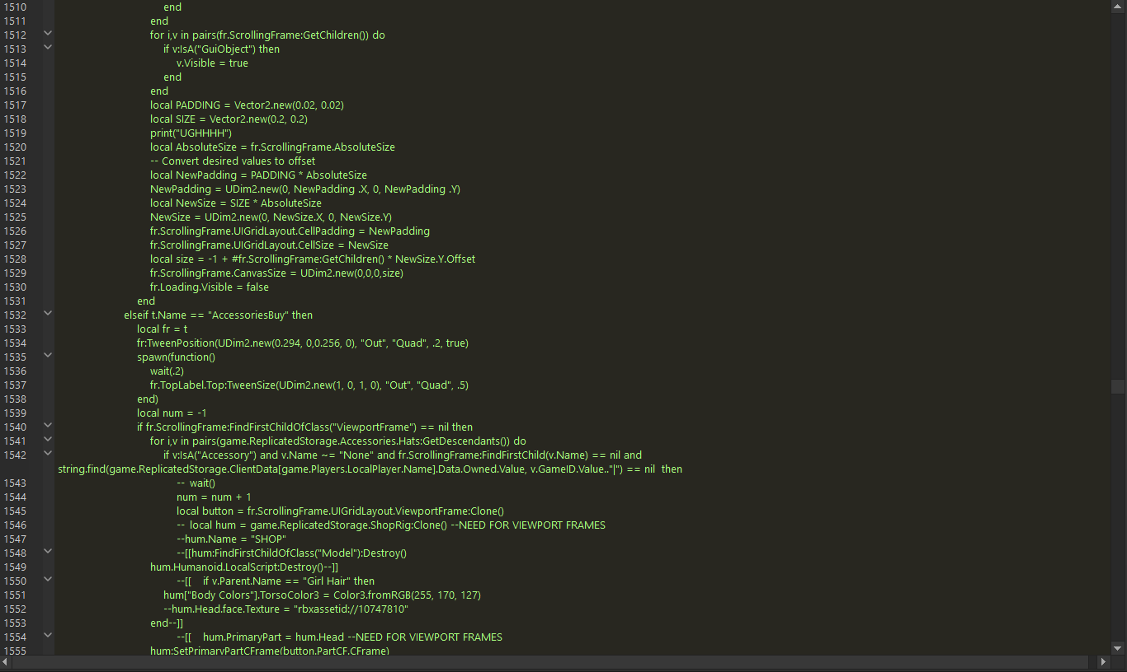
ANOTHER SOLUTION ?
Notes:
With a large application, u would be forgetting to call methods before methods
Time for __init__ method

Slide 13
__init__
How to use init method hear?
How to use init methods here?
Notes:
Remove learn_name method and add __init__ method

Slide 14
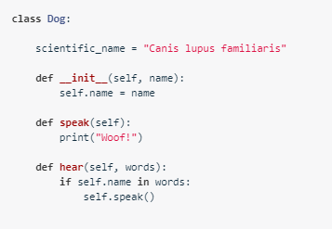
solution
How many arguments are needed for creating a new object?

Slide 15
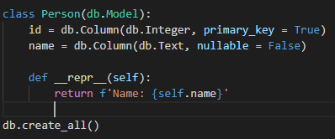
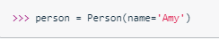
Anything missing?
Notes:
We don’t have init method
This is already implemented

Slide 16
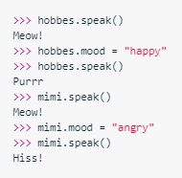
Cats now ☺_

Slide 17
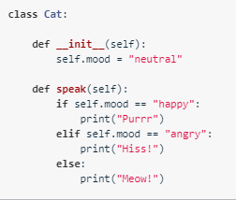
solution

Slide 18
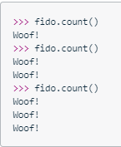
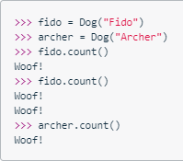
Count specific to dog

Slide 19
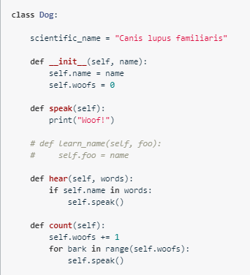

Slide 20
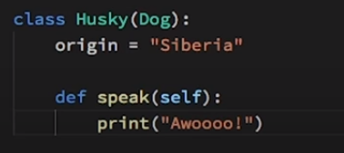
Inheritance
What’s the output ?
Notes:
Awoooo

Slide 21
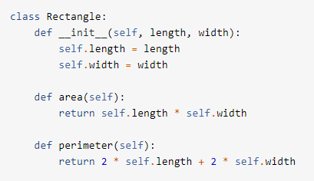
Keyword?
Notes:
https://realpython.com/python-super/
I am searching for the keyword super

Slide 22
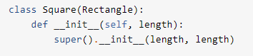

Slide 23
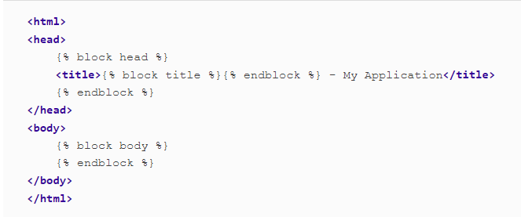
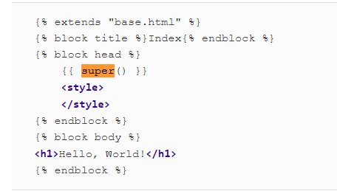
Templates/ modify this

Slide 24
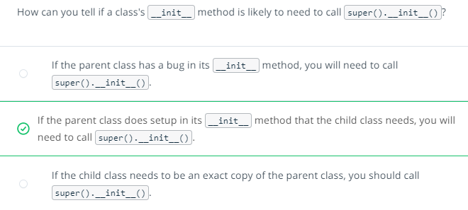

Slide 25

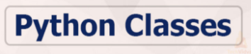
Naming convention

Slide 26
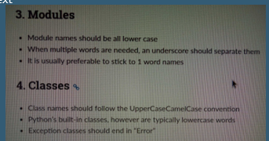
Naming conventions

Slide 27
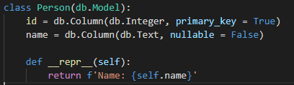
naming
Notes:
__name__ for FLASK to identify its location and thus can find templates folder for example
The __tablename__ class variable defines the name of the table in the database. Flask-SQLAlchemy assigns a default table name if __tablename__ is omitted, but those default names do not follow the popular convention of using plurals for table names, so it is best to name tables explicitly.
Table name here is person

Slide 28
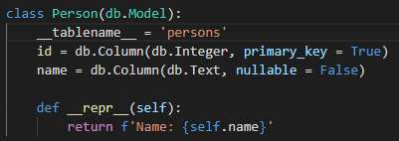
solution

Slide 29

project

Slide 30
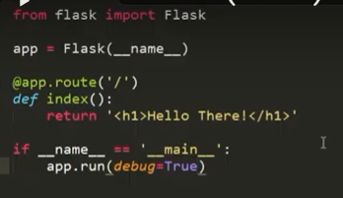
ELABORATE
Which method?
Notes:
Route flask.com/something this something is the route
Once someone visits this route, the function gets triggered .. However, it is http request in general, not get only
Index is called a view function
Decorator simply u have your function with something above and something below
If name__ main? When is this code not run? When the file is imported
But when the file is run, this code will run

Slide 31
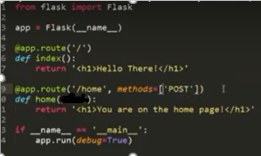
What will happen?
localhost:5000

Slide 32
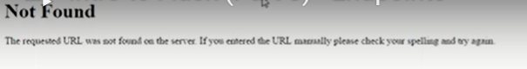

Slide 33
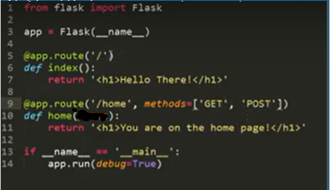
How to add variables?
Notes:
Place is wrong

Slide 34
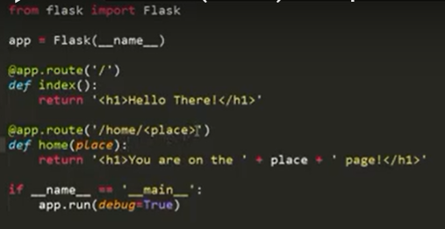
solution

Slide 35
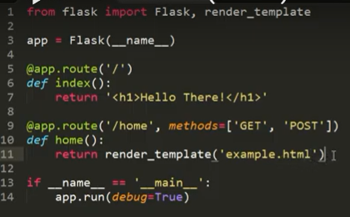
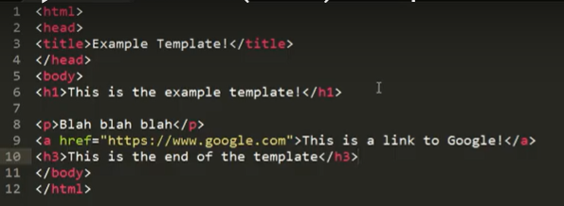
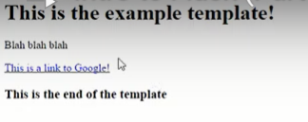
templates
How to add logic to templates?

Slide 36
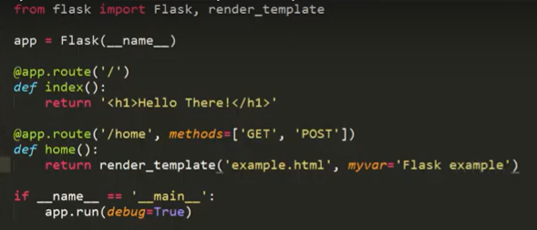
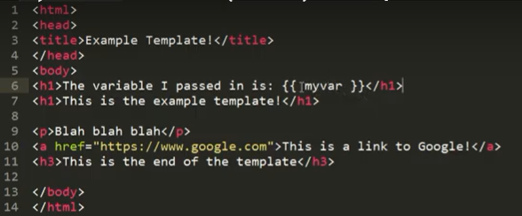
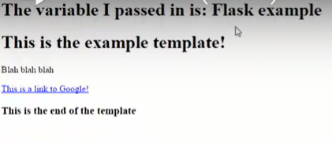
How to pass variables? [jinja]
How to print only if variable is passed in flask?

Slide 37
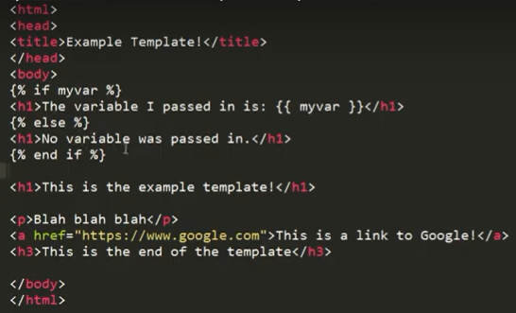
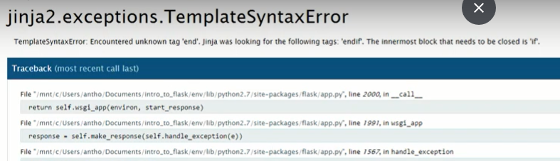
Use if conditional
Why an error?

Slide 38
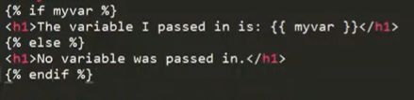
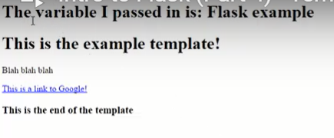
solution

Slide 39
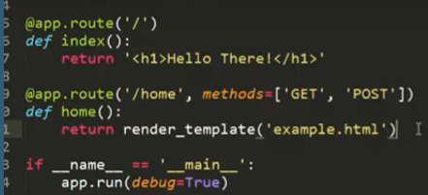
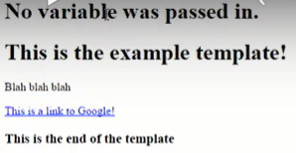
Removing the variable

Slide 40
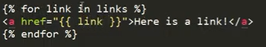
For loops

Slide 41

More info?

Slide 42
Why flask-sqlalchemy?

Slide 43

Notes:
Let’s examine how

Slide 44
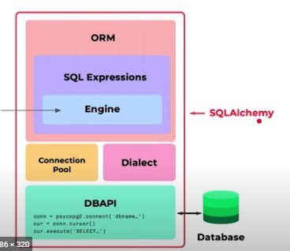
overview

Slide 45


Dialects
Notes:
https://docs.sqlalchemy.org/en/14/dialects/
Why do we need dialects if SQL are the same ?
Answer : minor differences

Slide 46



dialects
Microsoft SQL
MySQL or postgres
Notes:
https://auth0.com/blog/sqlalchemy-orm-tutorial-for-python-developers/

Slide 47


Postgres vs sqlite
Check link in footer
Notes:
https://tableplus.com/blog/2018/08/sqlite-vs-postgresql-which-database-to-use-and-why.html#:~:text=The%20SQLite%20library%20is%20less,is%20much%20larger%20in%20size.&text=SQLite%20stores%20the%20database%20in,located%20anywhere%20in%20the%20directory.&text=PostgreSQL%20is%20only%20portable%20after,can%20be%20a%20hassle%20sometimes.
Since Heroku uses Postgres, it will be good for us to develop locally on the same database.

Slide 48

Notes:
This is how to set postgres
What about sqlite ?

Slide 49
Sqlite trial

Slide 50
Connection pool

Slide 51
overview

Slide 52

Notes:
How do these relate ?
How to map these over these ?

Slide 53



ORM

Slide 54



flexibility

Slide 55

Sql injection

Slide 56

Why flask-sqlalchemy?
Notes:
Change in db or in flask are synced.

Slide 57

Query options

Slide 58

query
Notes:
How does each one translates in SQL ?

Slide 59


Common query filters
Notes:
https://docs.sqlalchemy.org/en/13/orm/tutorial.html#common-filter-operators

Slide 60



All vs first
Notes:
.all() will give this error
Always use print to show ur output in the console

Slide 61


Slide 62


Slide 63




Filter vs filter_by
Notes:
Difference between filter and filter_by in SQLAlchemy
filter_by uses keyword arguments, whereas filter allows pythonic filtering arguments like filter(User.name=="john")
keyword arguments = kwagrs
The point of using filter_by is to be able to write jut the field name, for that class, no questions asked - while fllter requires the actual column object - which usually will require one to type (and to read) at least a redundant class name.
https://stackoverflow.com/questions/2128505/difference-between-filter-and-filter-by-in-sqlalchemy

Slide 64
Filter vs filter_by
It is more flexible than using filter_by itself, and is especially useful when querying from a joined table where you want to filter by attributes that span across multiple models
ID | name | Project_id
1 | Ahmed | 1
1 | Ahmed | 2
2 | araby | 1
ID | name
1 | Titanic
2 | hitler
Notes:
Joined tables with attributes having the same names.
It is more flexible than using filter_by itself, and is especially useful when querying from a joined table where you want to filter by attributes that span across multiple models

Slide 65

Transient pending and persistent
Which session?
Notes:
Which session is being handled? How can we pack out transactions into appropriate sessions?
Db.session handles everything for us.

Slide 66

solution
Notes:
Apply rollback on pending or after flush ..
Always before flush

Slide 67

complete

Slide 68

Object lifecycle

Slide 69

Transient pending and persistent

Slide 70

solution

Slide 71

pending vs transient
Notes:
Why flush state is important ?
Flush gives u an in memory representation of what would u get back if u committed
There is a sort of cashing in here that makes SQLALCHEMY a bit better performer than DBAPI

Slide 72

transactions

Slide 73

beware

Slide 74

Major concept

Slide 75

Sqlalchemy options
Notes:
Flask-SQLAlchemy requires all models to define a primary key column, which is commonly named id.
Index is used for speed purposes

Slide 76

constraints

Slide 77

solution

Slide 78



Create fake data

Slide 79


Implementing fake library
Why session add is inside the for loop?
Notes:
Inside for loop to create 100 customers then commit is used only once.
Fake date this year
fake date between
U can use random library and apply different probs

Slide 80

Want to know more?

Slide 81

Let’s start flask

Slide 82

Hello stranger app

Slide 83

Hello stranger app

Slide 84

Flask shell

Slide 85


Wt forms using flask

Slide 86

Wtforms html fields

Slide 87

Wtforms validators

Slide 88

Food tracking app

Slide 89
Questions and feedback

Slide 90
Thank you

